Slide 1

Wheat Market Analysis and Forecasting
Presented by: Mohamad Lababidi- Ahmad Set
Major: Data Science
Course: Introduction to economics
Teacher of the course: Dr. Bachir Iskandar

Slide 2
TABLE OF CONTENTS
01
02
03
04
Introduction
Commodity Background
Data Collection
Data Analysis and Visualization
05
Interpretation and Strategic Insights
06
Conclusion

Slide 3
INTRODUCTION
Wheat is one of the most important staple crops globally, playing a critical role in the food security of many nations. As an essential agricultural commodity, its price is influenced by a variety of factors, including production levels, global demand, geopolitical events, weather conditions, and macroeconomic indicators. This report aims to analyze wheat market dynamics, including historical price fluctuations, influential factors, and forecasting future trends. Through data science techniques, we will explore correlations between wheat prices and key economic variables, followed by a forecasting model to predict future trends.

Slide 4
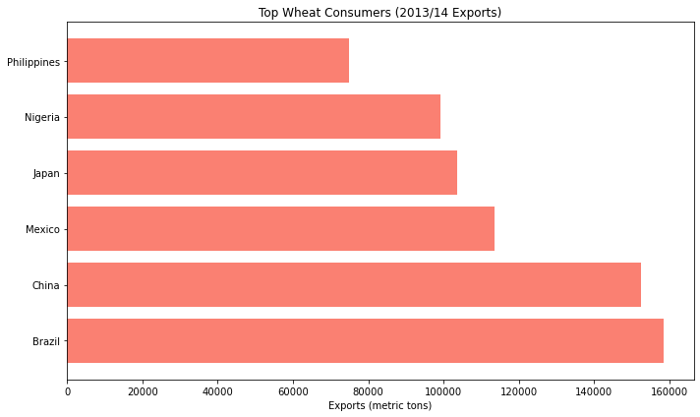
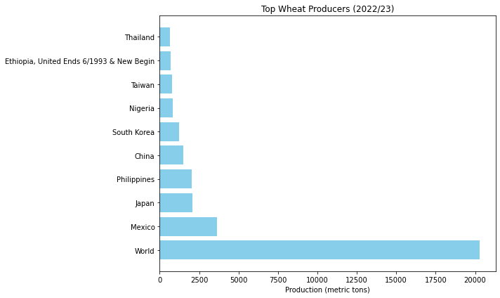
Commodity Background
Wheat is a primary source of nutrition for millions worldwide, used not only for food but also in the production of animal feed, biofuels, and other industrial uses. The commodity market for wheat is global.
Types of Wheat: There are two major types of wheat:
Hard wheat (used in bread, pasta, etc.), primarily grown in regions like the U.S. Great Plains and Canada.
Soft wheat (used for cakes, biscuits, etc.), grown in regions like the U.S. Midwest, Europe, and Asia.
Wheat Production and Consumption:
Wheat is one of the most important global crops, widely produced in different countries.
• Major producers: Mexico, Japan and Philippines, China…
• Major consumers: Brazil, China, Mexico, Japan, Nigeria, Philippines

Slide 5
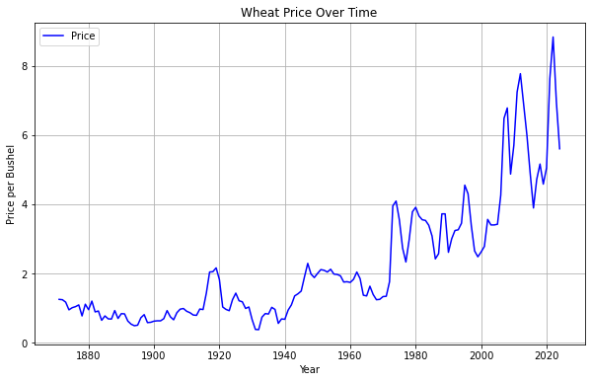
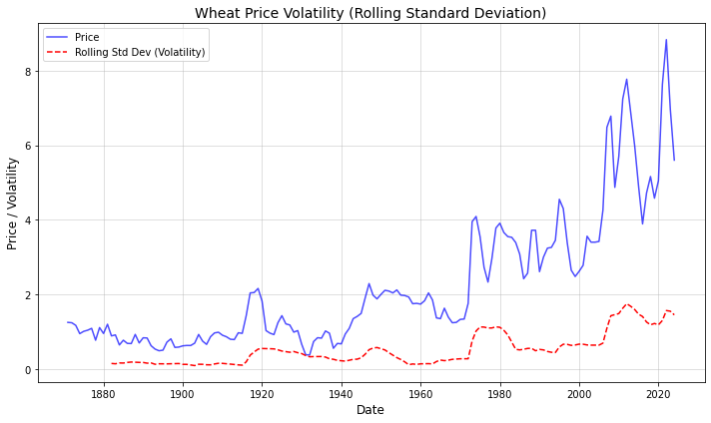
Price Trends and Volatility
• Volatility Trends: The price of wheat has fluctuated significantly, with notable spikes during periods of drought and geopolitical instability (e.g., Russia-Ukraine conflict).
• Price Trends: The long-term trend shows moderate increases in wheat prices, reflecting global population growth and increasing demand for wheat.

Slide 6
Key Factors Influencing The Wheat Market
Supply and Demand
Geopolitical Influences
The balance between wheat production and consumption is the primary determinant of its market price.
Political instability in major wheat-producing countries or regions can disrupt supply chains and drive prices up.
Seasonal Effects
Macroeconomic Drivers
The annual harvest cycles, especially in the Northern and Southern Hemispheres, create seasonal price fluctuations.
Inflation rates, exchange rates, and global interest rates…

Slide 7
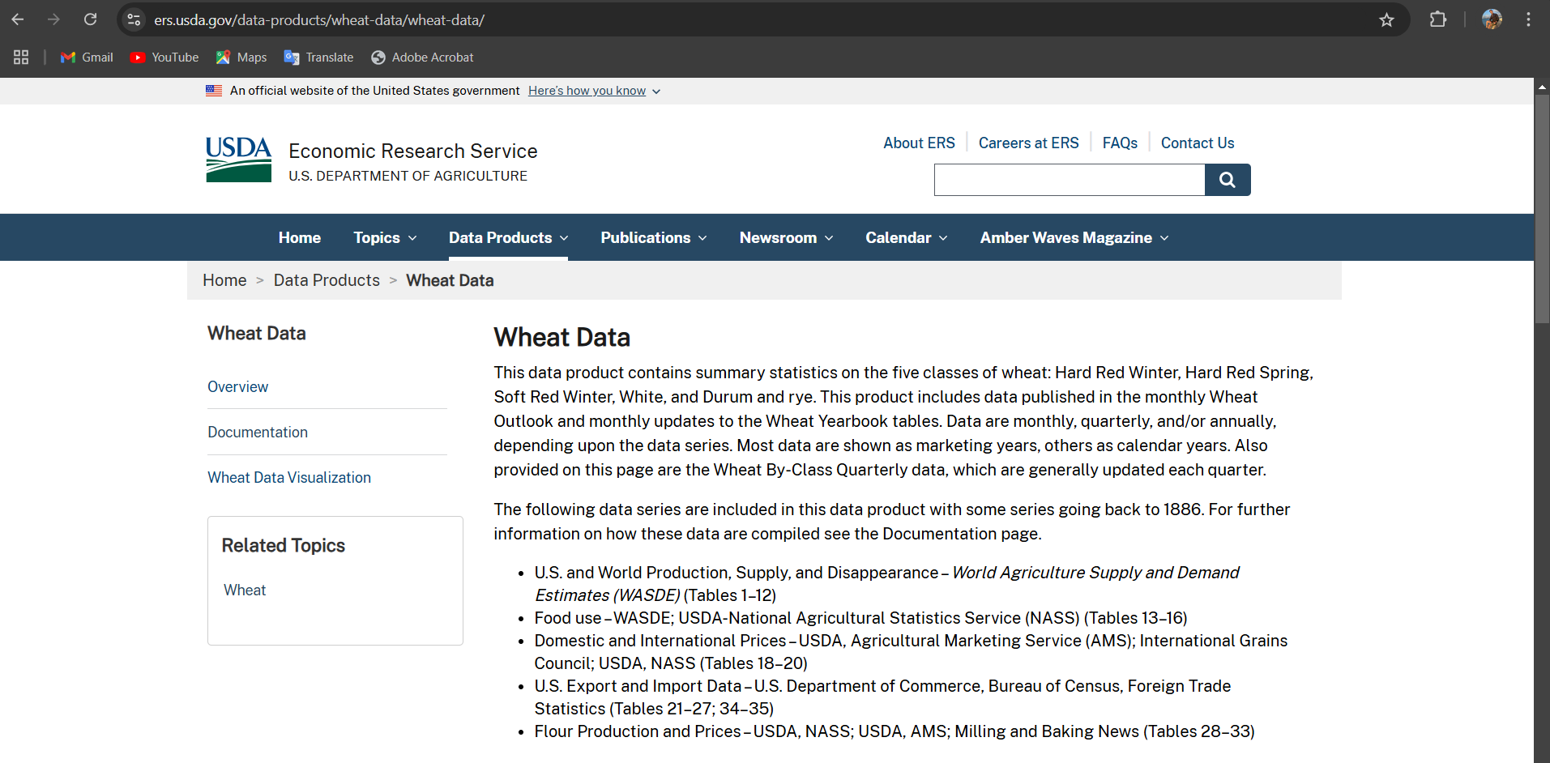
Where did we get these Data from? Tools and Resources: Python Libraries: Pandas, NumPy, Matplotlib, Seaborn, Statsmodels, Scikit-learn Data Sources: USDA, FAO, Trading Economics, UN Comtrade, World Bank, IMF

Slide 8
Data Analysis and Visualization

Slide 9
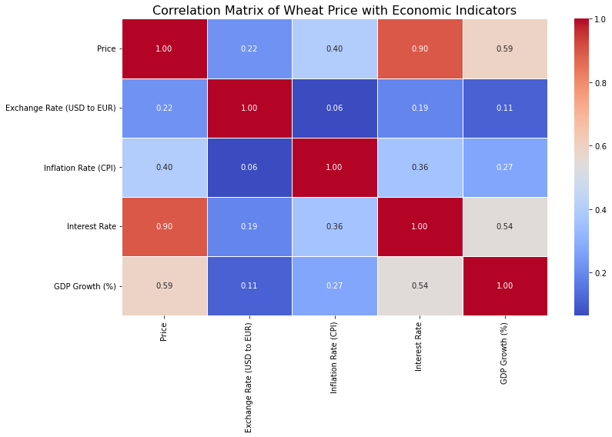
Correlation Heatmap 1
Wheat Prices and Economic Indicators
Price vs. GDP (0.59): A moderately positive correlation suggests that as GDP increases, wheat prices tend to rise. This likely reflects higher demand in a growing economy.
Price vs. Interest Rate (0.90): A very strong positive correlation indicates that as interest rates rise, wheat prices also tend to increase, which is somewhat counterintuitive but could be due to specific market dynamics.
Price vs. Inflation Rate (0.40): A moderate positive correlation shows that higher inflation tends to drive wheat prices up, likely due to increased production costs.
Price vs. Exchange Rate (0.22): A weak positive correlation suggests that exchange rates have a minor impact on wheat prices, with other factors playing a larger role.

Slide 10
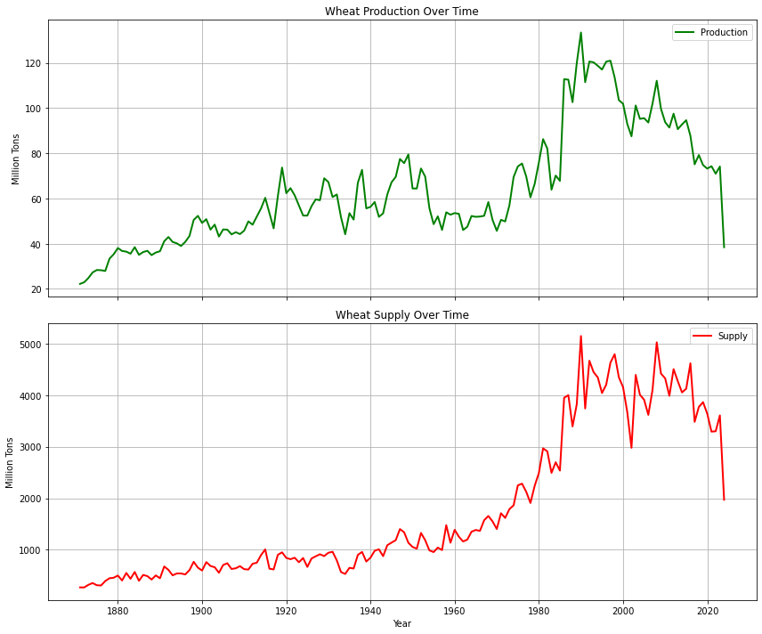
Wheat Production and Supply Over Time
Supply: Wheat supply has shown significant fluctuations and a general upward trend over time, especially after the 1940s, while production has remained relatively stable and lower in magnitude.
Production: Wheat production has shown a steady increase over time, with significant growth between the late 19th century and mid-20th century. However, there are notable fluctuations in recent decades.
Conclusion:
The growing divergence between supply and production may indicate increased reliance on external sources or stockpiles to meet demand, possibly influenced by global trade and consumption patterns.

Slide 11
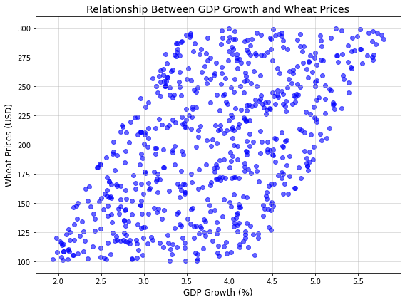
Relationship between GDP Growth and Wheat Prices
No linear relationship between GDP growth and Wheat prices

Slide 12
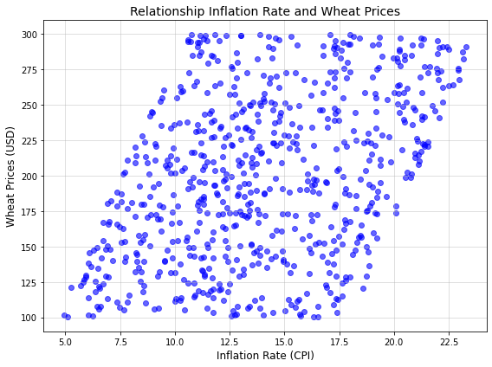
Relationship Inflation Rate and Wheat Prices
No linear relationship between Inflation Rate and Wheat prices

Slide 13
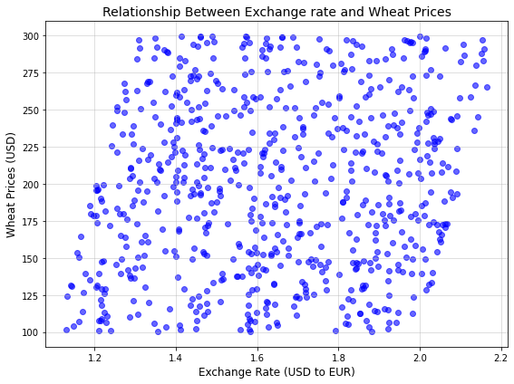
Relationship Exchange Rate and Wheat Prices
No linear Relationship between Exchange Rate and Wheat Prices

Slide 14
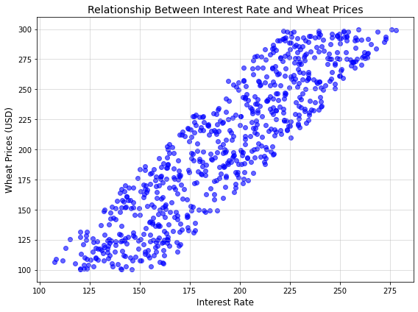
Relationship Interest Rate and Wheat Prices
A significant linear relationship between Interest Rate and Wheat Prices

Slide 15
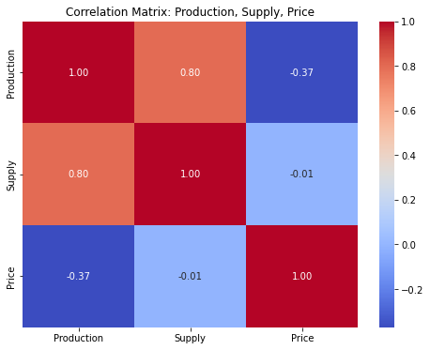
Correlation Heatmap 2
Production, Supply, Wheat Price
Price vs. Supply (-0.01): The near-zero correlation indicates that changes in wheat supply have almost no direct impact on wheat prices, suggesting other factors are more influential.
Price vs. Production (-0.37): A moderate negative correlation suggests that higher wheat production is somewhat associated with lower prices, possibly due to oversupply or economies of scale.
What can we conclude?
Wheat prices are influenced by many factors beyond production and supply, such as global economic conditions, weather patterns, or geopolitical events. So, while these correlations may reflect some relationships, they might not fully capture the complexity of the market.

Slide 16
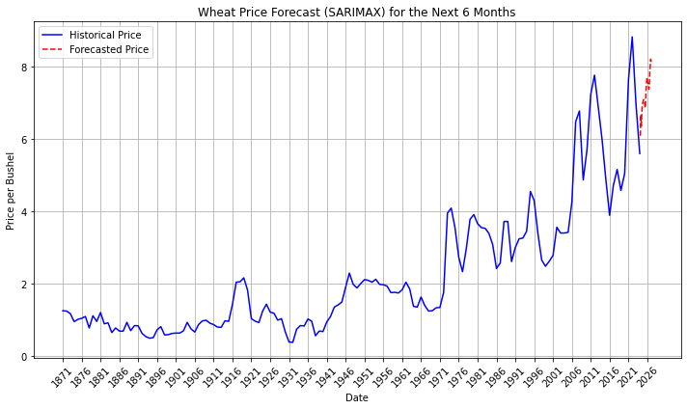
Forecasting
What are the expected prices of wheat?
What can we conclude from this chart?
Seasonal variations (e.g., reduced supply in certain months).
Increasing demand globally.
External shocks, such as geopolitical events or trade policies.
Economic Implications:
For Producers:
Rising prices are beneficial for producers, indicating potential for higher revenues if they maintain or increase production.
For Consumers: Higher prices may strain budgets, particularly in wheat-importing countries. Governments or businesses might need to consider stockpiling or subsidies.
For Investors: A consistent increase in wheat prices could make the commodity market attractive for short-term investment.
Forecasting Overview:
SARIMAX Model: The SARIMAX model is effective for both long and short-term price predictions, incorporating seasonal patterns and providing a reliable forecast for the next 3 years while accounting for both trend and seasonality.

Slide 17
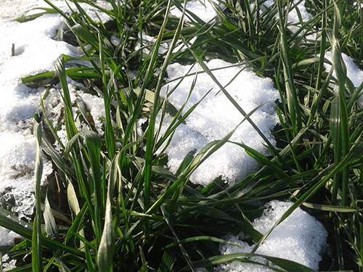
How weather can affect Wheat?
Temperature Optimal Range:
Wheat grows best in temperatures between 10°C to 15°C.
High Temperatures:
Excessive heat, especially during flowering and grain-filling stages, can reduce yields due to heat stress. Known as "heat shock," it can cause poor kernel development.
Low Temperatures:
Frost during the early growth stages (e.g., germination) or at flowering can kill the crop or reduce yields.
But how Russia and Ukraine are one of the top producers of Wheat?

Slide 18
Strategic Insights
Investors
Producers
Policy Makers
• Long-Term Investment: Investors should consider wheat-related futures and exchange-traded funds (ETFs) as part of a diversified portfolio, as wheat remains a key global commodity.
• Short-Term Volatility: Due to price volatility, short-term investors should monitor geopolitical events and climatic conditions.
• Yield Enhancement: Small-scale wheat producers should focus on improving yield through investment in more resilient agricultural practices (e.g., drought-resistant varieties).
• Market Access: Better access to markets and credit can help producers stabilize their incomes and reduce exposure to price fluctuations.
• Support for Small Farmers: Governments should offer subsidies and financial support to small-scale farmers to increase wheat production and ensure food security.
• Climate Resilience: Policies aimed at mitigating climate change’s impact on agriculture (e.g., drought management and irrigation) can help stabilize wheat production.

Slide 19
CONCLUSIONS
The wheat market is influenced by a combination of economic, environmental, and geopolitical factors. Price fluctuations are driven by supply and demand, macroeconomic indicators, and external shocks such as climate events or political tensions. Understanding these factors through data science techniques, including regression analysis and forecasting models, can help stakeholders make informed decisions.
The wheat market is expected to remain volatile due to external factors, but long-term growth in demand driven by population growth and changing dietary patterns provides opportunities for producers and investors.
Forecasting techniques like SARIMAX will continue to improve, helping predict future trends with greater accuracy.

Slide 20

THANKS!
Do you have any questions?
References:
https://www.ers.usda.gov/
https://www.w3schools.com/

